Slide 1
Knowing our students – knowing yourself?
ScotHELD Conference
Catriona Cunningham
17th June 2022

Slide 2
Photo by Daniel Salcius on Unsplash
Notes:
Before we begin take a moment - Where are you now? Who is with you in this room? Whose voice(s) are you listening to?

Slide 3
Knowing who you are?
What are your values within a ‘broken system’? (Grant, 2021)
What are your assumptions? Acknowledging the ‘danger of single story’ (Adichie, 2009)
‘Third space professionals’ (Whitchurch, 2008)?
Photo by Luis Villasmil on Unsplash
Notes:
Before we begin to think about our students, surely we need to know who we are?

Slide 4
What are our students telling us?
Who are your students, and who do you know?
Notions of ‘resilience’ and ‘belonging’ as complex and problematic
Importance of ‘pedagogies of mattering’ (Gravett, Taylor & Fairchild, 2021)

Slide 5
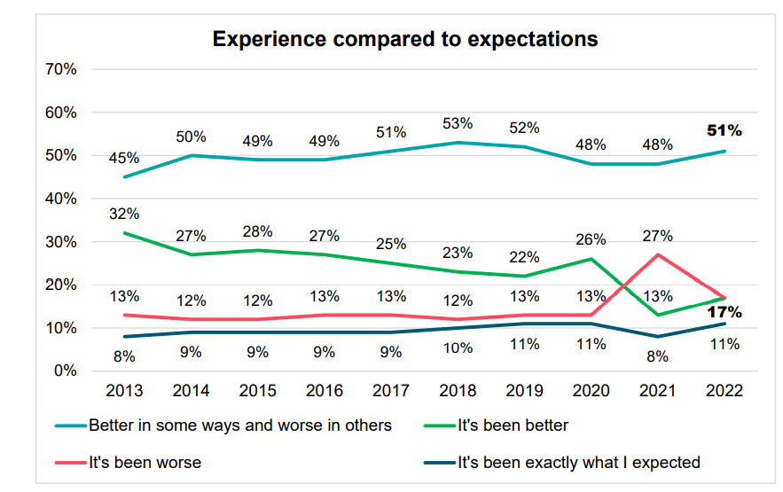
Student Academic Experience Survey 2022 Jonathan Neves and Alexis Brown
Student Academic Experience Survey 2022 | Advance HE (advance-he.ac.uk)

Slide 6
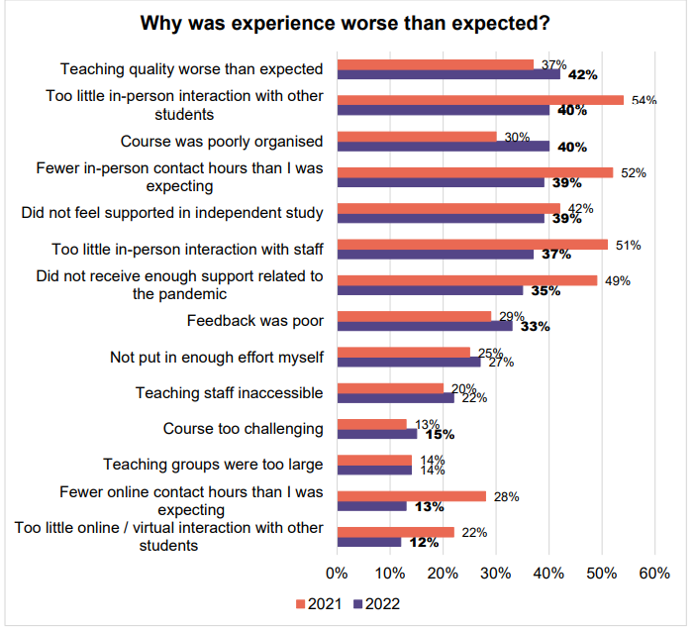

Slide 7
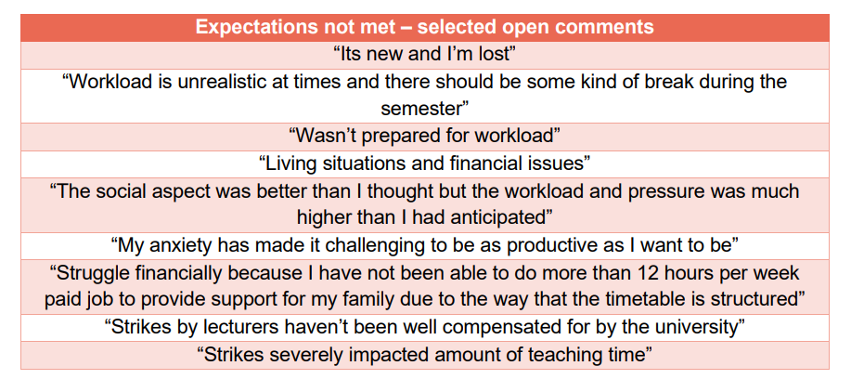

Slide 8
What would improve academic experience?
Quality of feedback
Quantity of in-person teaching
Administrative failures
Mental health support
UCU strike action
Student Academic Experience Survey 2022 | Advance HE (advance-he.ac.uk)

Slide 9
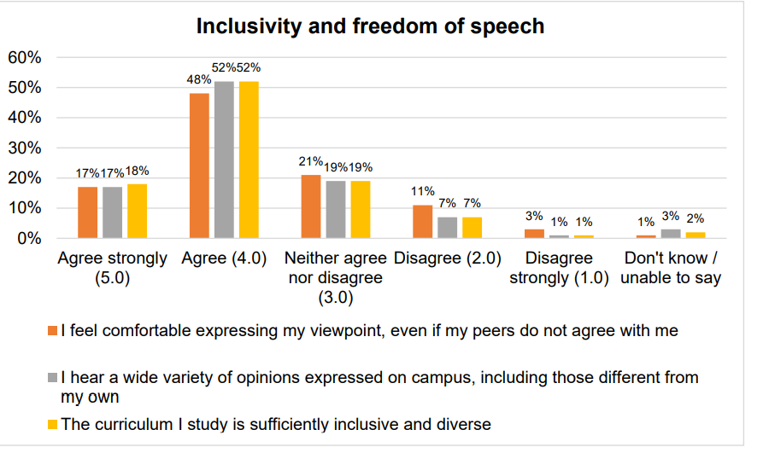

Slide 10
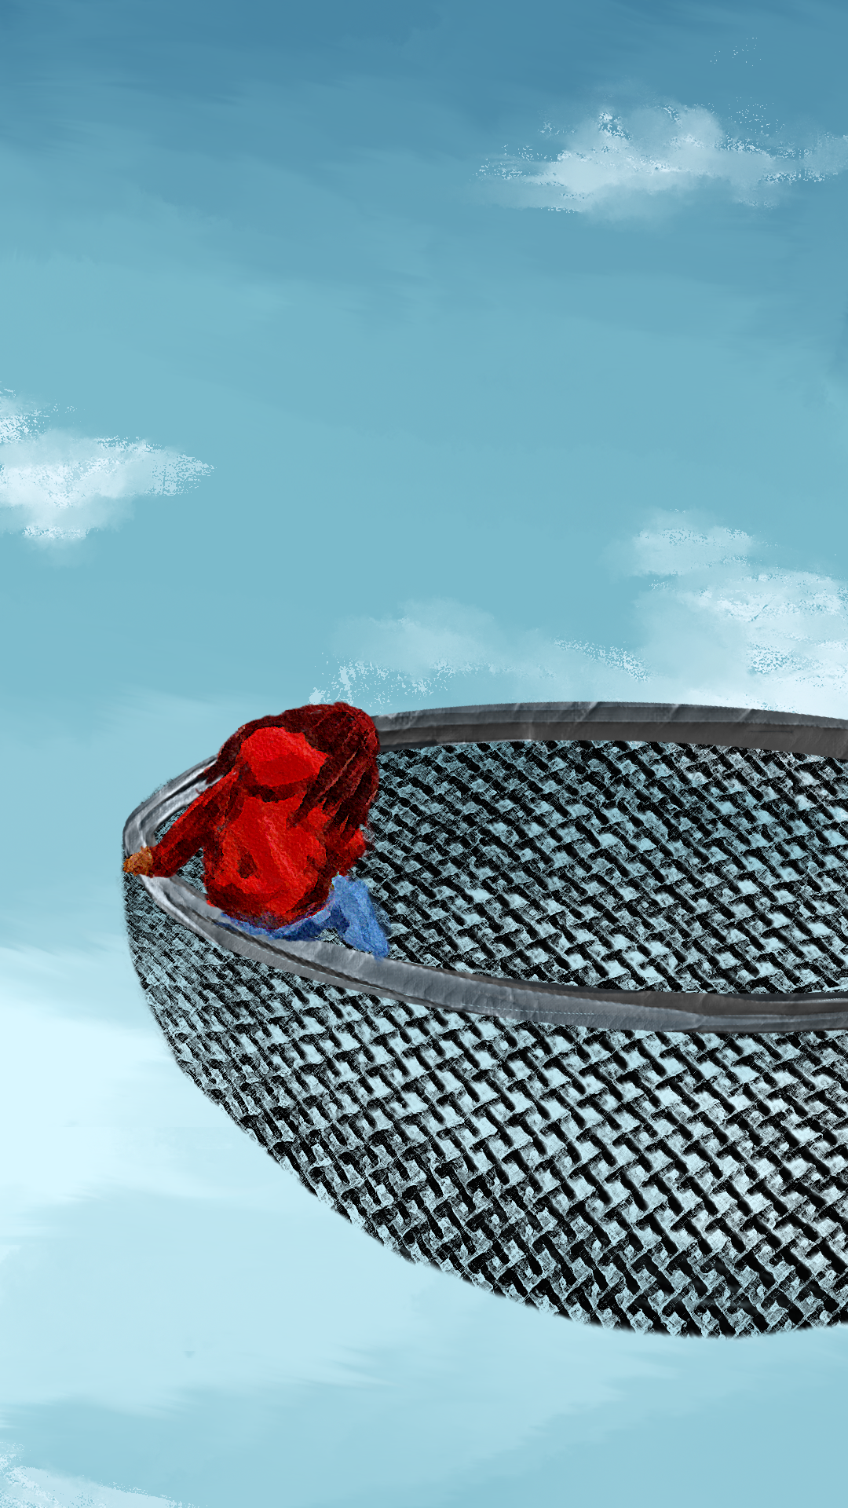
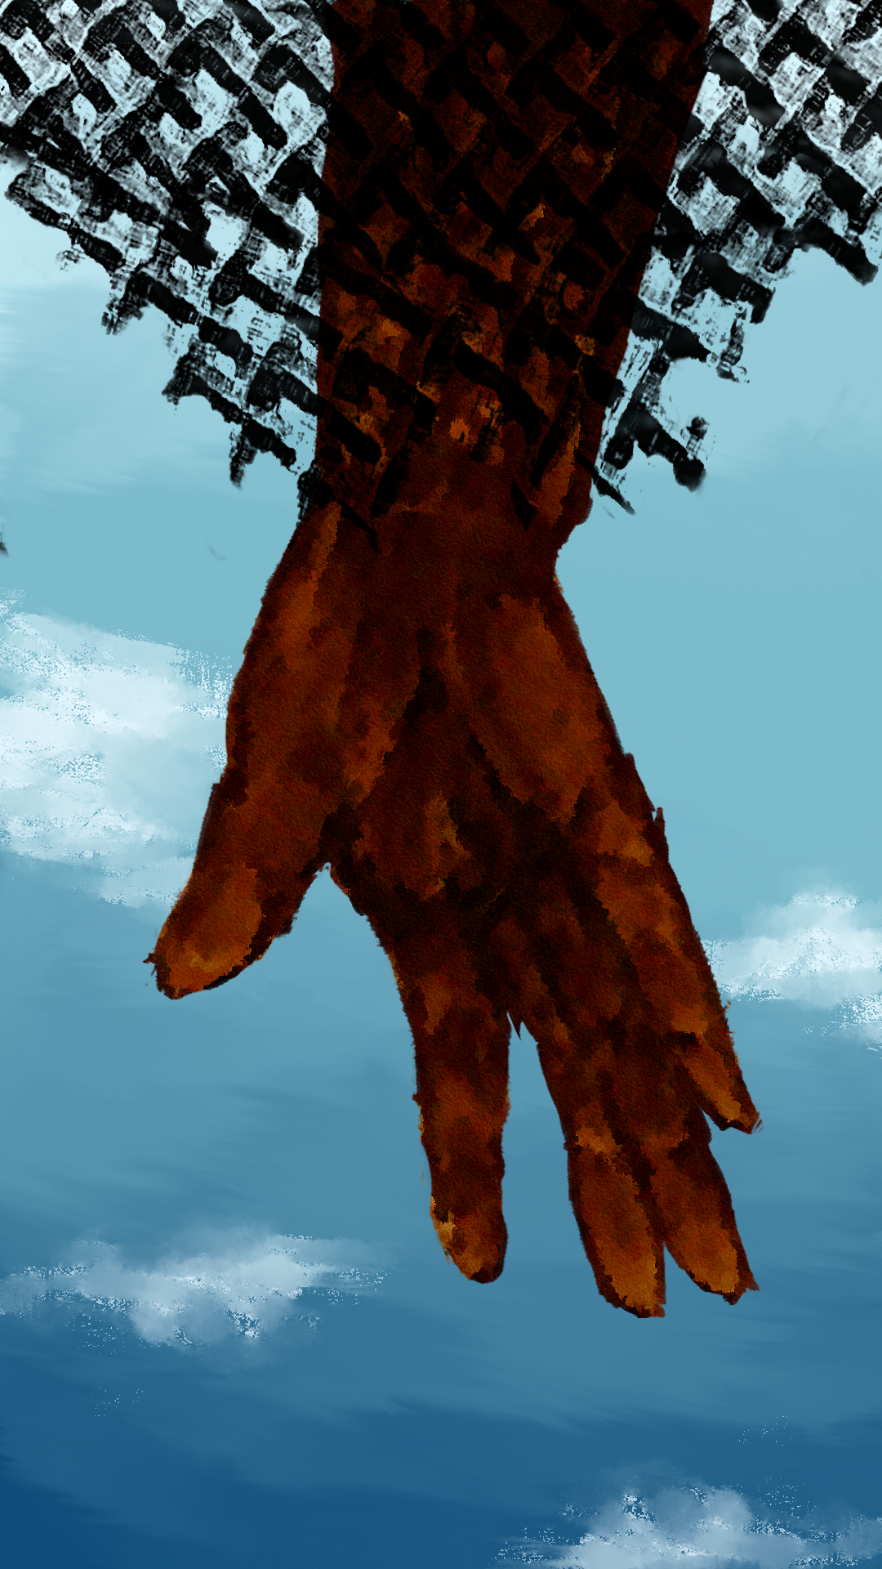
Artist: Jasmine Millington, QAA Project ‘Decolonsing the Curriculum’
Notes:
https://www.youtube.com/watch?v=o8m7THScaAk&list=PLnQ0SRXmULAr6KnQqjUSxtqgEEGhPs3Uf&index=3
https://www.youtube.com/watch?v=6sXRaQYni3I&list=PLnQ0SRXmULAr6KnQqjUSxtqgEEGhPs3Uf&index=4

Slide 11
Ideas put forward by our students
listening to different perspectives from staff and student fosters knowledge and awareness of unfamiliar experiences
frank discussions are liberating but should be had on a collective, not only individual, level
setting up spaces where staff can discuss their sieves/challenges/experiences
empowering people so that they are confident in discussing the discomfort and injustice they encounter
increase leadership representation - amongst students, staff and visiting lecturers/experts, placement providers and in the resources that we use
learning about and creating ‘identity safe’ classrooms
allow anonymity and collect written submissions (link to Nicol’s ‘inner feedback, 2021)

Slide 12
References
Adichie, C. N. (2009, October). Chimamanda Ngozi Adichie: The danger of a single story. https://www.ted.com/talks/chimamanda_ngozi_adichie_the_danger_of_a_single_story
Grant, J. (2021). The New power university – the social purpose of higher education in the 21st century. Pearson.
Gravett, K., Taylor, C. & Fairchild, N. (2021) Pedagogies of mattering: re-conceptualising relational pedagogies in higher education. Teaching in Higher Education. DOI: 10.1080/13562517.2021.1989580
Whitchurch, C. (2008). Shifting identities and blurring boundaries: The emergence of third space professionals in UK higher education. Higher Education Quarterly, 62(4), 377–396.

