Slide 1
“No news is good news”: the challenges of measuring impact in developing learning
Dr Mary Pryor
Student Learning Service
Centre for Academic Development
ScotHELD: Do We Develop Learning? Impact, Evaluation and Learning Gain
27 January 2023

Slide 2
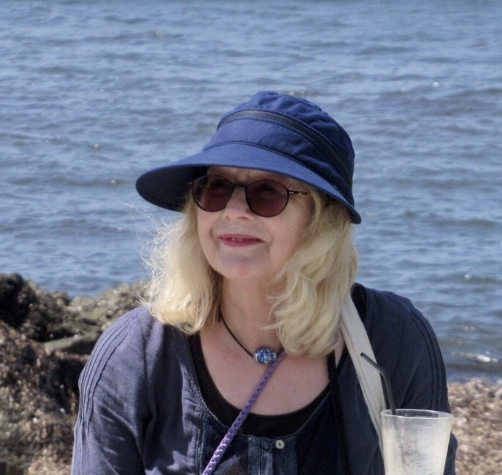
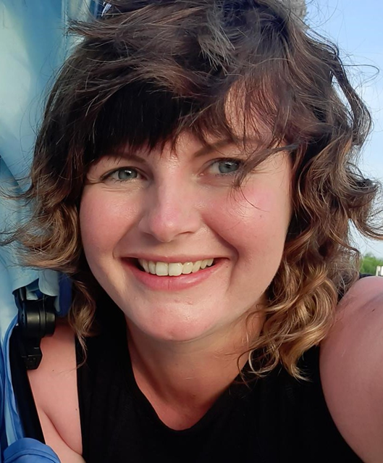
Today’s Presenter(s)
Dr Mary Pryor
Senior Academic Skills Adviser
m.r.pryor@abdn.ac.uk
Dr Chloe Alexander
Academic Skills Adviser (Academic Writing)
chloe.alexander@abdn.ac.uk

Slide 3
Measuring Impact?
For whom is the measurement of impact?
Own research? Window dressing? Resource management?
Can we claim impact without knowledge of other sources of inspiration/breakthrough?
Holistic partnership or divisive competition?
Should we not be thinking in terms of how we forge links in the learning chain?
e.g., Partnerships with SLS colleagues / academic and admin staff / library colleagues / student support services
Beware the survey that asks students to choose between specific services!

Slide 4
How do we meet with students?
Request for a one-to-one appointment (online / in-person):
May be by recommendation from staff or other student, or own decision
May come only to one or two sessions with an SLS adviser
Anecdotal feedback from student emails can indicate positive impact; sometimes these arrive at the point of graduation – long after meetings

Slide 5
UG and PGT workshops – on campus and online
Signing up / attending:
May come to different to different topics / aspects of study
Some students come regularly, as if to a ‘course’
Some may come only once
Non-participation doesn’t necessarily = lack of engagement
Anecdotal feedback from student emails to us can indicate positive impact and sometimes these arrive at the point of graduation – long after meetings

Slide 6
In-course sessions
UGs & PGTs
Frequent requests from academic departments for return sessions indicate that academic colleagues value our contribution to their courses, for example:
Business / Education / Psychology (academic writing and academic integrity)
Business / Medical Sciences / Engineering (maths skills)
Medicine / Dentistry (time-management, revision & exam strategies, effective reading and notetaking)
UG 1st years
Academic writing course across four Academic Schools (Achieved or not-achieved)
Academic integrity ‘quiz’ for all new first–year students across the University (achieved or not achieved) as part of an induction course

Slide 7
Postgraduate Research Students: one-to-one and workshops
A more sustained working relationship working on aspects of academic writing – 1-1s (in liaison with supervisors)
Academic writing workshops – demand exceeds resource

Slide 8
Specific learning differences (SpLDs) / mental ill-health
Liaison with Student Support Advisers
One-to-one academic skills development with specialist advisers
Working in tandem with other Student Support teams
Funded (Disabled Student Allowance) and non-funded students – balancing the increasing demands

Slide 9
Measuring impact?
‘No news may well be good news’
Student decides has no further need for future study advice sessions
No further need for workshops
Students feel confident in independent learning
Students access the SLS online learning resources
Catalyst for change of learning approaches

