Slide 1
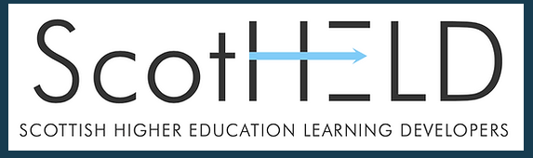
Knowing our students: The PAS story
Iain Arnott (English for Academic Purposes)
Tayo Oluwadare (Academic Skills)
Janis MacCallum (School of Applied Sciences)

Slide 2
New 2-stage Masters programme for overseas students in the School of Applied Science (SAS).
History of previous 2 year PAS program:
Poor outcomes: results, unhappy students, ACO issues, staff workload.
High rate of intervention: specialised pastoral support in place, but little used.
New approach:
2-stage, 2 year MSc programme.
Stage 1: 6 UG level modules: 3 modules topic specific, 3 based on general skills.
First intake January 2022 – Students have now completed first half of stage 1.
Notes:
High rate of intervention: specialised pastoral support in place, but little used. This led to involvement of Tayo (AS) and Iain (EAP) in PAS program.
Alan McLachlan in recruitment brought together a team to look at this and discuss new approaches.

Slide 3
Expectations and Outcomes
Expectations of the students at MSc level are traditionally explained clearly during induction, however these are frequently not met. New programme has been designed to bring the expectations of staff and students closer together.
Example module:
Professional Practice 1 is delivered by SAS in cooperation with Academic Skills (AS), English for Professional Purposes (EAP) and Information Services (IS)
Focuses on general academic skills with specific application: literature searching and review, critical thinking, writing, referencing and reflection.
Skills related tasks are completed weekly and complied into a portfolio for final assessment.
Outcomes: PP1 results: 36 students: 32 submissions, 4 non-submission: 29 Pass (highest 80%, lowest 51%, mean 62.8%); 2 referred for ACO
Notes:
Students are also informed of support available, but this is not used as much as it should be, or students engage too late for it to be effective, while they are potentially dealing with resits and ACO issues. The workload can become overwhelming for the students.
Other 2 (traditional) PAS modules: 60% and 30% pass rate. New PAS pass rate @tri 1: 90%
Comparison with old version of programme: first two tri 1 modules pass rates: Introduction to Analytical Science (21% in 2020-21) Drug Design and Chemotherapy (33% in 2020-21)

Slide 4
How is reflection embedded?
Various tasks related directly to reflection
Weekly feedback provided on portfolio work
Members of the teaching team could use personal reflections to drive engagement from the students in order to help their development of this skill.
Student reflections
Examples and discussion
Notes:
Transformation?
Confidence?

Slide 5
Teacher reflections
Interdepartmental cooperation: closer ties between SAS, IS, AS and EAP.
More contract with students: lessons, tutorials, and conversations outside of class times.
Easier intervention in student issues, and more reactive to student needs.

Slide 6


