Slide 1
Unlocking the Door to HE
Anonymous Access student contribution, ‘Picturing Learning’ Padlet board, 2022
Dr Clare Brown
Access & Skills Coordinator
University of Glasgow

Slide 2
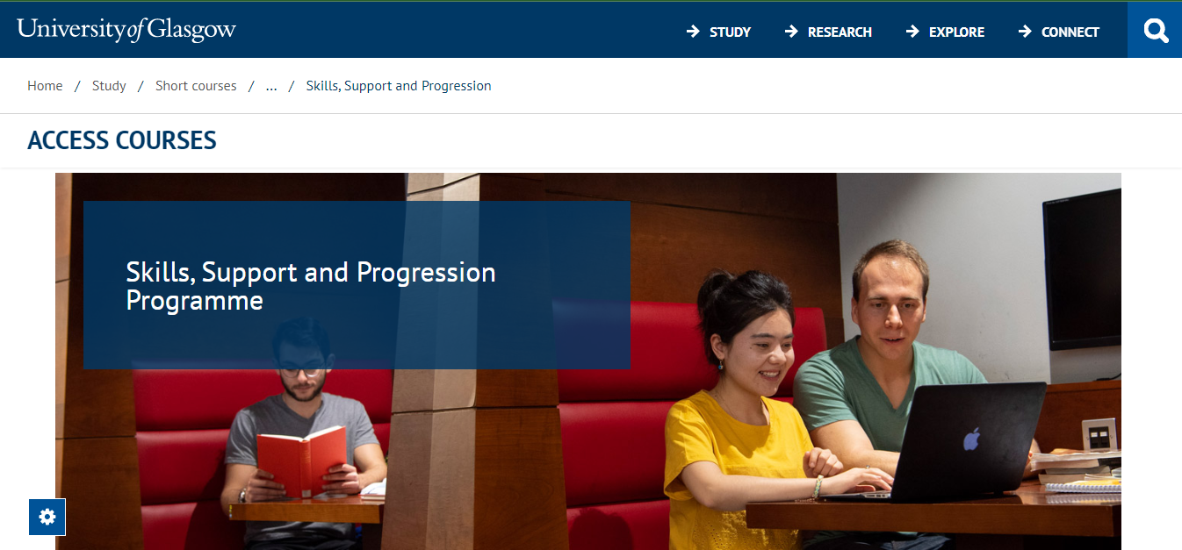

Slide 3
Did we need an ‘academic skills’ module?
YES
NO
SWAP
Summer School
Student feedback
Retention & success
Good L1 preparedness
Subject specific better
Extra pressure on
p/t students
Anonymous Access student contribution, ‘Picturing Learning’ Padlet board, 2022

Slide 4
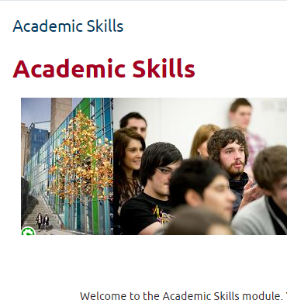
‘Academic Skills’ course → Access Essentials course
Asynchronous
UofG Summer School
Transition into UG study
Moodle
Long explanatory videos
Reflective exercise
Quizzes
Mandatory

Slide 5
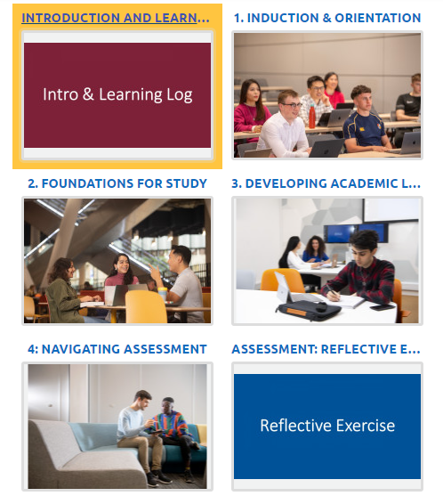
‘Academic Skills’ course → Access Essentials course
Asynchronous
UofG Summer School Access to HE students
Transition into UG study HE
Moodle
Long explanatory chunked videos
Reflective exercise + learning log
Quizzes + other interactive elements
Mandatory optional

Slide 6
What went well
Well
Not so well
Learning logs
Picturing learning
Comments on videos
Note taking exercise
Last minute addition
Optional
Self-selection
Disparity within classes
STEM relevant content needed
Disconnect between tutors & AE messaging
Overall engagement

Slide 7
Picturing learning activity
https://padlet.com/clarebrown2/picturing-learning-baz6uirsftdbgbzh/slideshow
Notes:
Early point in access – point in time

Slide 8
Topics for exploration
Making a generic module relevant across disciplines
Signposting a coherent journey
induction – learning development – transition
Gauging development of learning – how do they picture it now?
Evaluating impact

