Slide 1
Down the rabbit hole? We develop learning – but what is learning?
Ursula Canton
Glasgow Caledonian University
ScotHELD Winter 2023

Slide 2
Learning Developers develop….
Please describe what we develop. Your description CANNOT use the word ‘learning’.
Notes:
If we think about impact, we need to think about impact on what → name includes this, but what is learning? Or rather how many different answers to that can we find;
What do we develop? Ask them to give an answer that does NOT include the word learning (it’s like playing Taboo)
Expect to find: - lists of specific things (writing, ICT, time management)
References to learners (become better learners)
See if there is a more abstract level – how do we define learning?
Such a fuzzy term! Development also fuzzy!

Slide 3
Learning Development
Learning
Development = ‘the steady growth of something so that it becomes more advanced, stronger, etc.’ (OALD)
Notes:
Definitions of le
2 strategies: ignore the fuzziness and focus on less abstract and more practical levels OR take up the gauntlet
Why second is useful: the better our understanding, the more orientation we have for practice – greater clarity what we want to achieve (and why)
arning discussed before

Slide 4
Definitions of Learning
Learning as a quantitative increase in knowledge. Learning is acquiring information or ‘knowing a lot’.
Learning as memorising. Learning is storing information that can be reproduced.
Learning as acquiring facts, skills, and methods that can be retained and used as necessary.
Learning as making sense or abstracting meaning. Learning involves relating parts of the subject matter to each other and to the real world.
Learning as interpreting and understanding reality in a different way. Learning involves comprehending the world by reinterpreting knowledge.
(quoted Säljö 1979 in Ramsden 1992: 26;
Notes:
PROCESS vs. PRODUCT
Which ones are process, which ones are product? Ask them to match – poll or similar
Parallel: knowing how and knowing why or declarative vs. procedural knowledge
(ten Berge and Hezewijk 1999)

Slide 5
Teaching: process and product
Methodology
How do I best do this and why in this way?
Results / Analysis
What do I find? What does this mean?
Research Question
What do I want to do and why?
Is it a question?
Is it precise?
Is there a short rationale?
Notes:
Explain how I taught this: comparison problem solving / research process (explanation); then ask them to write down their tentative research question and hand them round the circle; ask them to tick for each one they read that fulfils any of the 3 criteria on right
Explain where I’m hoping for a product of learning (better declarative knowledge of process involved in research); process (getting better at judging the quality of a tentative question)

Slide 6
Small Group Discussion
1) Share: where can you recognise elements of product / process in your own work? Can each member of group give 1 example where they try to teach learning as product / process?
2) Develop as a group: choose 1 example of teaching that results in a product / teaching that aims at improving process respectively. Discuss in your group: how could the impact of our teaching on the learning that results from it be demonstrated?

Slide 7
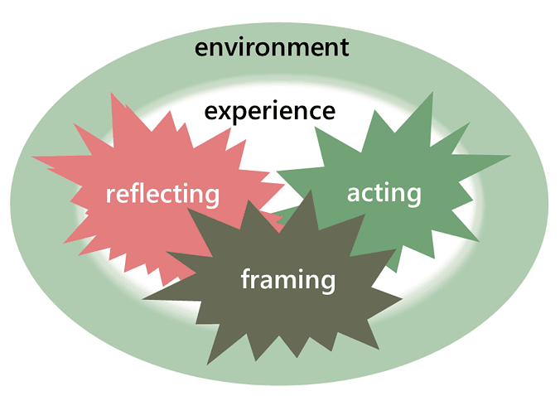
Definitions of Learning
Notes:
Short version: reflecting: ‘active, persistent, and careful consideration of any belief or supposed form of knowledge in the light of the grounds that support it and the further conclusions to which it tends’ (Dewey 1933: 118).
Acting: = behaviour
Framing: interpretation, understanding and application in ‘one unified process’ (Gadamer 1979: 275).
How can we use this in our teaching: example:
Same as before; example: exercise with tentative questions in dissertation class: I want them to act (write down what they know about their question to externalise it); reflect on the patterns they can see in their peer’s work (to establish a basis for evaluation of their own work) and help them frame it in a different way (I need a great topic instead: what could I find out that is interesting for others and me)

Slide 8
Small Group Discussion
Share: where can you recognise elements of product / process in your own work? Can each member of group give 1 example where they try to foster one/ various of these processes to foster learning?
Develop as a group: choose 1 example and discuss: what kind of predicted impact does this manipulation have? Could this prediction be tested empirically?

Slide 9
Definition and Impact
Notes:
Wrap up:
What I hope we have seen through the discussions is that depending on the focus of our definition, we can think about impact in lots of different ways – think about them as lenses
Hope: this variety is a good antidote to simplistic measurements of impact (my pet hate: was it useful type questions)

Slide 10
References
Smith, M. K. (1999-2020). ‘Learning Theory’, The Encyclopedia of Pedagogy and Informal Education. [online] Available from: https://infed.org/mobi/learning-theory-models-product-and-process/. Retrieved: 19/01/2023
ten Berge, T., & van Hezewijk, R. (1999). Procedural and Declarative Knowledge: An Evolutionary Perspective. Theory & Psychology. 9(5), 605–624. https://doi.org/10.1177/0959354399095002

