Slide 1
Synchronising the Asynchronous
Dickson Telfer
Academic Development Tutor
School of Health & Life Sciences
Glasgow Caledonian University

Slide 2
School of Health & Life Sciences @GCU
Physiotherapy
Vision Sciences
Biomedical Sciences
Podiatry
Radiotherapy
Social Work
Diagnostic Imaging
Oral Health Sciences
Occupational Therapy
Psychology
Ambulance Academy
Nursing
Undergrad
Masters
Professional Studies in Nursing

Slide 3
Undergrad Nursing
Approximately 830 students per cohort
Academic Writing / Academic Performance regularly an issue
How well we know our students . . .
Pre-pandemic – Lots of third year nursing students presenting with gaps in their knowledge re academic writing, often linked to poor interpretation of the assignment question and/or lack of discussion and critical analysis (these students had often received borderline passes in first and second year)
My frustrations around this . . .

Slide 4
Covid hit
Right at the time when a revised, new programme was due to kick in for first year students
Prior to Covid, I had had meetings with the programme lead about introducing more Academic Development content in the new programme, but the logistics were to be determined. This fizzled out due to everyone suddenly working from home
I was then linked with a specific module, ‘Becoming a Graduate Nurse’ and began working with the module lead and module team, who were great. I was invited to all module team meetings and consulted on the wording of the module’s assignment question

Slide 5
Content
I made it clear that Academic Development content was necessary in the new programme, but so was material about academic mindset
How well we know our students . . .
We got the content to the students by . . .
Synchronising the asynchronous

Slide 8
Tuesday Afternoon 2-4pm
Facilitator 2
Facilitator 1
Facilitator 3
150*
students
150
students
150
students
Facilitator 4
Facilitator 5
*numbers are rough/average
150
students
230
students

Slide 9
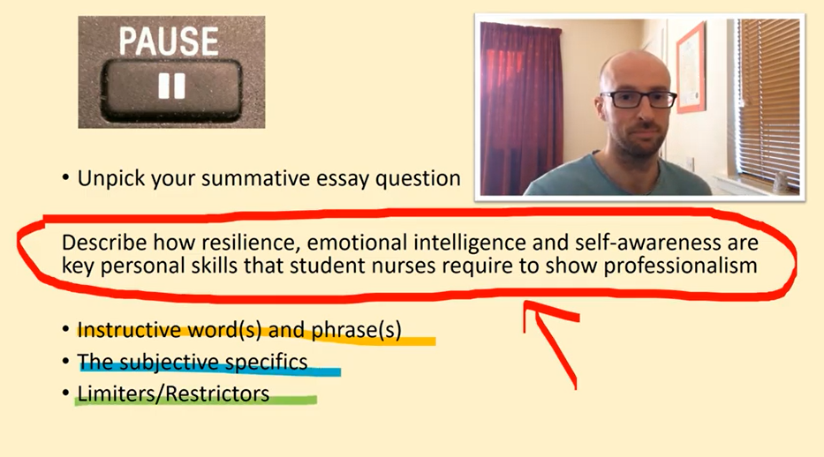

Slide 10
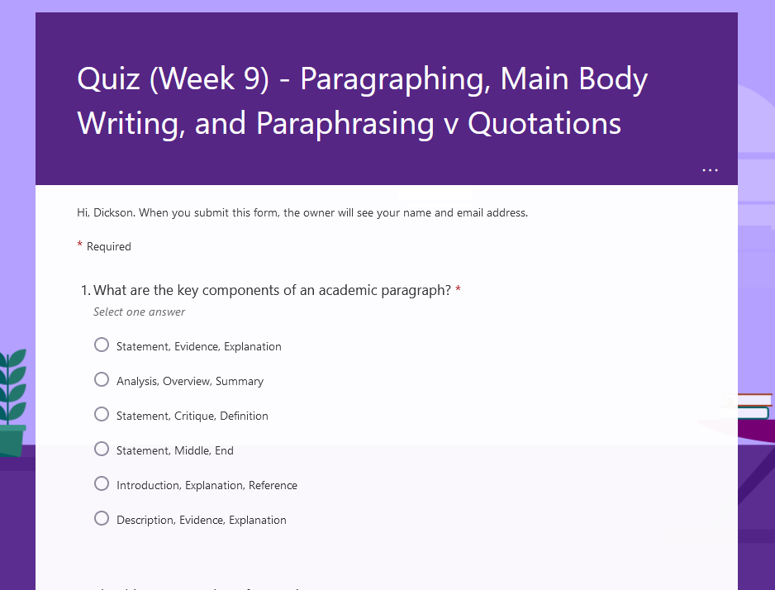

Slide 11
Following each Academic Development session . . .
Videos were made available after the facilitators’ sessions, accompanied by the respective quiz
Quizzes were to be completed prior to the following week’s session, but were also open ended. Engagement was decent, averaging on 500 students completing
Video views/re-visits could be tracked on YouTube. Again, engagement was decent . . .

Slide 12
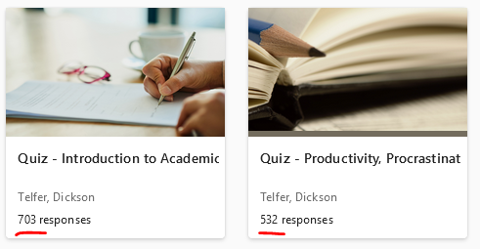

Slide 13
The Impact?
Fewer one-to-one appointments at the Learning Development Centre made by first year undergrad nurses
Progression from L1 in line with pre-pandemic
Progression from L2 higher than pre-pandemic

Slide 14
Also . . .
Lecturers have reported a decrease in the quality of academic writing (bangs head on wall)
Engagement
Covid – gaps in education / ‘traditional’ education
Back to the point that (a fairly high percentage of) nursing students are (probably) not motivated by academic performance

Slide 15
Second year videos
Intro to Critical Analysis – 264 views
Discursive writing – 355 views
Maybe because they are asynchronous rather than synchronised asynchronous

Slide 16
How well do we know our (1st year nursing) students?
They seem to prefer synchronous
They engage with mindset stuff as much as they do with academic writing stuff, sometimes more so
If given the right resources, they can meet assignment criteria, but not necessarily get high marks (there will, of course, be exceptions)
They don’t like writing essays (there will, of course, be exceptions)
Appointments are often about more than just the essay

Slide 17
